Slide 1
Design and Analysis of Algorithms
String Matching Algorithms
Chapter # 32

Slide 2
String Matching Problem
We assume that the text is an array T [1..N] of length n and that the pattern is an array P [1..M] of length m, where m << n. We also assume that the elements of P and T are characters in the finite alphabet Σ.
(e.g., Σ = {a,b} We want to find P = ‘aab’ in T = ‘abbaabaaaab’)

Slide 3
String Matching
The idea of the string matching problem is that we want to find all occurrences of the pattern P in the given text T.
We could use the brute force method for string matching, which utilizes iteration over T. At each letter, we compare the sequence against P until all letters match of until the end of the alphabet is reached.
The worst case scenario can reach O(N*M)

Slide 4
String Matching
Text string T[0..N-1] T = “abacaabaccabacabaabb”
Pattern string P[0..M-1] P = “abacab”
Where is the first instance of P in T? T[10..15] = P[0..5]
Typically N >>> M

Slide 5
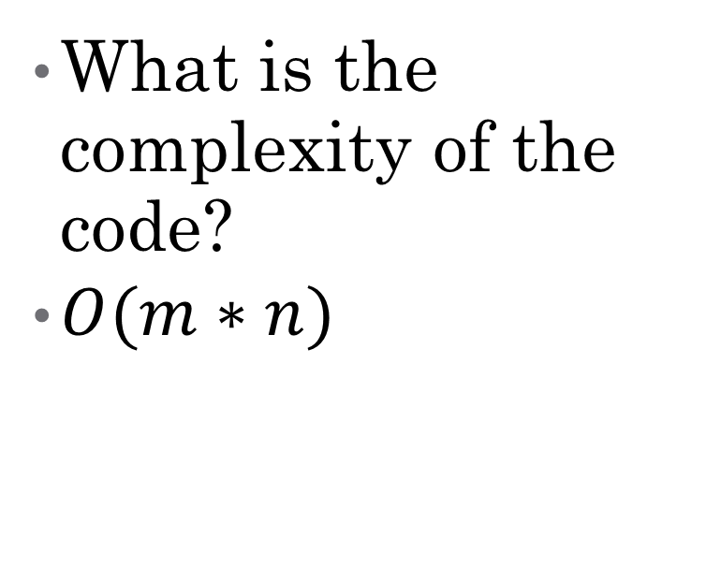
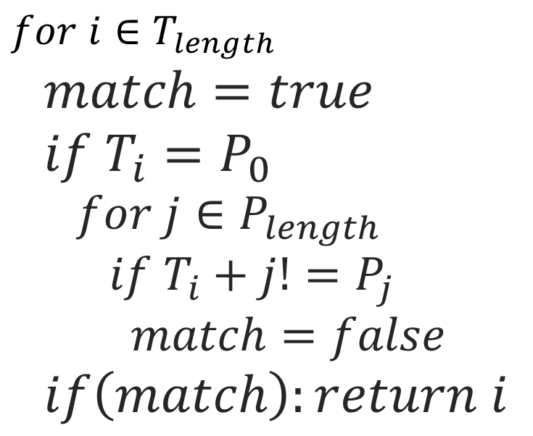
32.1 Naïve Algorithm
Naïve_algo(T,P)
$for i∈T_{length}$
$match=true$
$if T_{i}=P_{0}$
$for j∈P_{length}$
$if T_{i}+j!=P_{j}$
$match=false$
$if\left(match\right):return i$
What is the complexity of the code?
$O(m∗n)$

Slide 6
32.3 Finite State Automata (FSA)
FSA is a computing machine that takes
A string as an input
Outputs YES/NO answer
That is, the machine “accepts” or “rejects” the string
Input String
FSM
Yes / No

Slide 7
FSA Model
Input to a FSA
Strings built from a fixed alphabet {a,b,c}
Possible inputs: aa, aabbcc, a etc..
The Automaton/Machine
A directed graph
Nodes = States of the machine
Edges = Transition from one state to another
o
1

Slide 8

FSA Model
Special States
Start (q0) and Final (or Accepting) (q2)
Assume the alphabet is {a,b}
Which strings are accepted by this FSM?

Slide 9
Using FSM concept in Pattern Matching
Consider the alphabet {a,b,c}
Suppose we are looking for pattern “aabc”
Construct a finite automaton for “aabc” as follows
a
b|c
a
Start
a
a
b
c
0
1
2
3
4
c
b|c
b

Slide 10
32.2 Rabin-Karp
A string search algorithm which compares a string's hash values, rather than the strings themselves. For efficiency, the hash value of the next position in the text is easily computed from the hash value of the current position.

Slide 11
How Rabin-Karp works
Let characters in both arrays T and P be digits in radix-Σ notation. (Σ = (0,1,...,9)
Let p be the value of the characters in P
Choose a prime number q such that fits within a computer word to speed computations.
Compute (p mod q)
The value of p mod q is what we will be using to find all matches of the pattern P in T.
Notes:
To compute p, we use Horner’s rule
p = P[m] + 10(P[m-1] + 10(P[m-2] + … + 10(P[2] + 10(P[1]) …))
in which we can compute in time O(m).

Slide 12
How Rabin-Karp works (continued)
Compute (T[s+1, .., s+m] mod q) for s = 0 .. n-m
Test against P only those sequences in T having the same (mod q) value
(T[s+1, .., s+m] mod q) can be incrementally computed by subtracting the high-order digit, shifting, adding the low-order bit, all in modulo q arithmetic.
Notes:
Concept 3 will be further explained in the example of the Rabin-Karp algorithm at work

Slide 13
A Rabin-Karp example
Given T = 31415926535 and P = 26
We choose q = 11
P mod q = 26 mod 11 = 4
3
1
4
1
5
9
2
6
5
3
5
31 mod 11 = 9 not equal to 4
3
1
4
1
5
9
2
6
5
3
5
14 mod 11 = 3 not equal to 4
3
1
4
1
5
9
2
6
5
3
5
41 mod 11 = 8 not equal to 4
Notes:
Here, we are using a window of size 2. It corresponds to the length of the pattern. For the first window, we see that the value is 31. If we wanted to find out the value of the next window, we would merely subtract the high-order digit 3 and add the low-order digit 4, so that we are left with 14, the value of the second window.

Slide 14
Rabin-Karp example continued
3
1
4
1
5
9
2
6
5
3
5
15 mod 11 = 4 equal to 4 -> spurious hit
3
1
4
1
5
9
2
6
5
3
5
59 mod 11 = 4 equal to 4 -> spurious hit
3
1
4
1
5
9
2
6
5
3
5
92 mod 11 = 4 equal to 4 -> spurious hit
3
1
4
1
5
9
2
6
5
3
5
26 mod 11 = 4 equal to 4 -> an exact match!!
3
1
4
1
5
9
2
6
5
3
5
65 mod 11 = 10 not equal to 4
Notes:
Spurious hit is when we have a match but it isn’t an actual match to the pattern. When this happen, further testing is done.

Slide 15
Rabin-Karp example continued
3
1
4
1
5
9
2
6
5
3
5
53 mod 11 = 9 not equal to 4
3
1
4
1
5
9
2
6
5
3
5
35 mod 11 = 2 not equal to 4
As we can see, when a match is found, further testing is done to insure that a match has indeed been found.

Slide 16
Complexity
The running time of the Rabin-Karp algorithm in the worst-case scenario is O(n-m+1)m but it has a good average-case running time.
If the expected number of valid shifts is small O(1) and the prime q is chosen to be quite large, then the Rabin-Karp algorithm can be expected to run in time O(n+m) plus the time to required to process spurious hits.

